Slide 1
Panel Data Analysis
Presenter: Mei-Yun Hsieh
Date: 2017/09/05

Slide 2
Study design
Cross-section research---缺乏[時間]的訊息
單一時間點的狀態
無法判定因果關係，
無法判定狀態改變的時間點
Longitudinal research
time series
trend analysis
cohort analysis
panel study

Slide 3
Panel study
固定的對象
多個時間點
長期重複追蹤調查
結合了Cross-section與Longitudinal的資訊

Slide 4
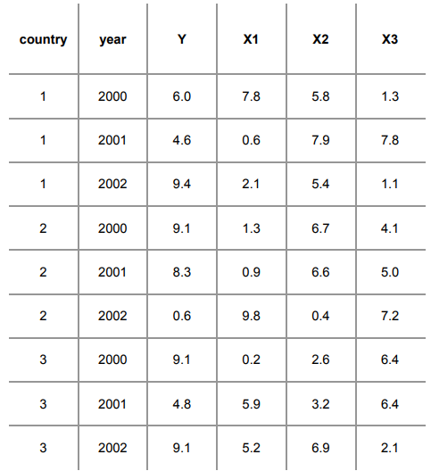
Data

Slide 5
Before model, Stata
You need to set Stata to handle panel data by using the command xtset. type:

Slide 6
Model
Hausman Test :
Fixed-Effect Model:
假設研究只對所擁有之樣本作推論
最小平方虛擬變數模型 (Least Square Dummy Variable Model, LSDV)
加入虛擬變數(dummy variable)以衡量不被觀察的變數(unobserved variables)對模型的影響
Random-Effect Model:
將樣本視為取自一個母群體的隨機樣本
Generalized least squares (GLS)

Slide 7
Hausman Test, Stata
If this is < 0.05 (i.e. significant) use fixed effects.

Slide 8
Fixed-Effect Model
We assume that something within the individual may impact or bias the predictor or outcome variables and we need to control for this.
FE model is that those time-invariant characteristics are unique to the individual and should not be correlated with other individual characteristics.
Fixed-effects models are designed to study the causes of changes within a person [or entity].

Slide 9
Fixed-Effect Model, Stata
Fixed effects: n entity-specific intercepts using xtreg and the option fe.
If this number is < 0.05 then your model is ok. This is a test (F) to see whether all the coefficients in the model are different than zero.

Slide 10
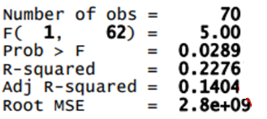
Fixed-Effect Model, Stata
Another way to estimate fixed effects: n entity-specific intercepts (using areg)
absorb(country):Hide the binary variables for each entity
If this number is < 0.05 then your model is ok. This is a test (F) to see whether all the coefficients in the model are different than zero.

Slide 11
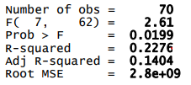
Fixed-Effect Model, Stata
common intercept and n-1 binary regressors (using dummies and regress)
Notice the “xi:” (interaction expansion) to automatically generate dummy variables
Notice the “i.” before the indicator variable for entities
If this number is < 0.05 then your model is ok. This is a test (F) to see whether all the coefficients in the model are different than zero.

Slide 12
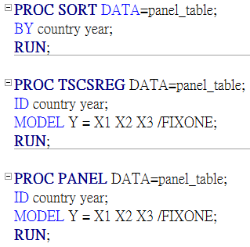
Fixed-Effect Model, SAS

Slide 13
Random-Effect Model
The variation across entities is assumed to be random and uncorrelated with the predictor or independent variables included in the model.
In random-effects you need to specify those individual characteristics that may or may not influence the predictor variables.
RE allows to generalize the inferences beyond the sample used in the model.

Slide 14
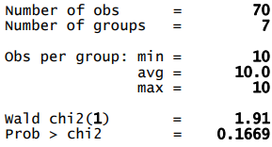
Random-Effect Model, Stata
You can estimate a random effects model using xtreg and the option re.
If this number is < 0.05 then your model is ok. This is a test (F) to see whether all the coefficients in the model are different than zero.

Slide 15
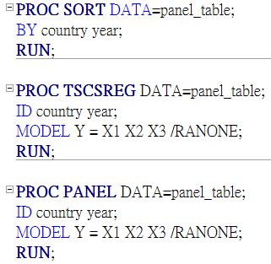
Random-Effect Model, SAS

Slide 16
Fixed Effect versus Random Effect Models

Slide 17
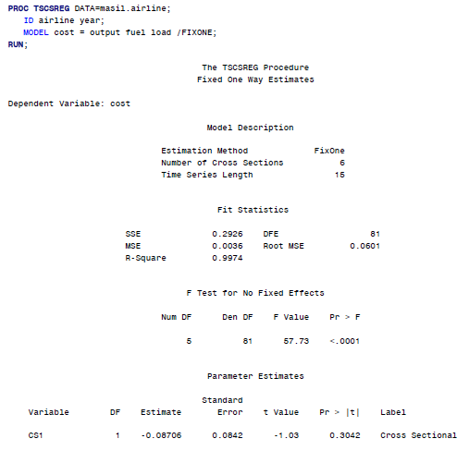
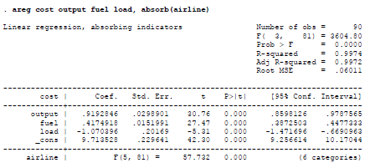
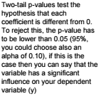
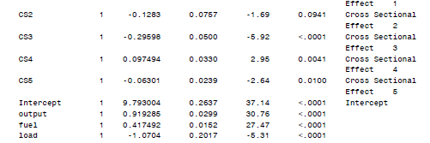
SAS
Stata

Slide 18
Reference
Torres-Reyna, Oscar. "Panel data analysis fixed and random effects using Stata (v. 4.2)." Data & Statistical Services, Priceton niversity (2007).
Park, Hun Myoung. "Linear regression models for panel data using SAS, Stata, LIMDEP, and SPSS." (2015).
葉光輝. "[尋找機制與過程: 長期追蹤研究的功用] 回應文." αβγ 量化研究學刊 2.1 (2008): 27-33.

