Slide 1
FloTrac 簡易操作說明
陳靖汝 Rocio
Territory Manager, Critical Care Mobile : 0975-529-165 E-mail: chingju_chen@edwards.com

Slide 2
FloTrac (A-line+FloTrac)
若遇到術中病人緊急情況需要使用，可直接更換中間段即可。

Slide 3
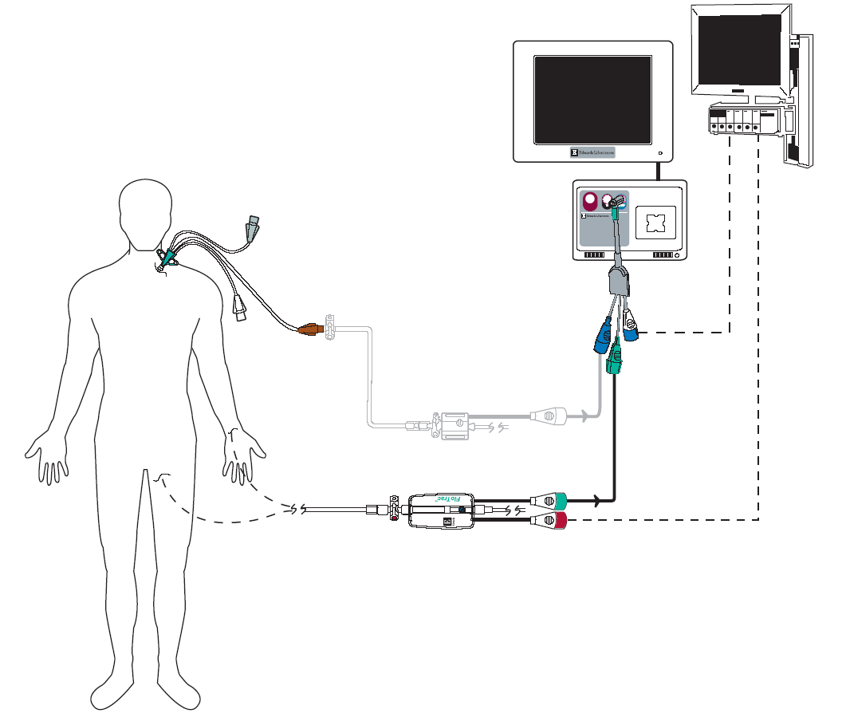
FloTrac sensor (A-line+FloTrac)
EV1000
Bedside
Monitor
Pressure
Transducer*
BP Cable須2條
FloTrac sensor

Slide 4
Vigileo機器操作

Slide 5
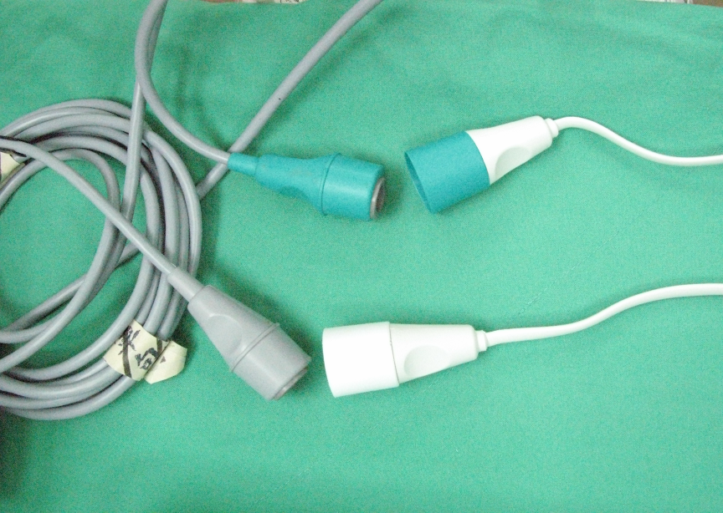
Starting Operation – Cable Connection
↓機器CABLE
↑ Besibe A-line CABLE

Slide 6
Starting Operation – FloTrac 操作步驟
1. Press on/off botton
2. Entering Patient Information and BSA ( Press Continue to Main Screen ) 確實輸入病人資料 性別/年齡/身高/體重 –後按下 Continue 進入主畫面

Slide 7
Starting Operation – FloTrac 操作步驟
3. Highlighted the CO Frame 選擇CO 參數框
4. Entey CO Menu, select “Zero Arterial Pressure” 進入 CO 主目錄,選擇 “ 動脈壓歸零” Beside monitor 歸零動作不用與 Vigileo 同步。
(CCO 約 2-6 分顯示)

Slide 8
導覽欄
快速屏幕轉換
屏幕選擇
臨床作業
設置
屏幕快拍 (需先插入USB)
警報靜音 (2分鐘)

Slide 9
輸入病人資料
1
2

Slide 10
歸零 Zero & Waveform
1

Slide 11
歸零 Zero & Waveform (反白處)
CO無需校正
1
1
2

Slide 12
Key in CVP (EV1000- 黑螢幕)
1
2

Slide 13
6 & 12 SVR相差100左右
1
2

Slide 14
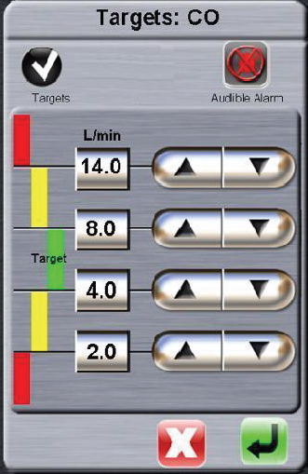
EV1000 操作設定
碰觸圓形範圍即可更改
Alarm值設定
可關閉或打開警報聲音
功能設定
螢幕拍照紀錄,須先接上隨身碟
Alarm silence 2分鐘

Slide 15
EV1000 操作設定
碰觸圓形外圍可更改顯示參數

Slide 16
計價代碼
無需再拆額外A-line
Notes:
SW 處置碼47036,2405點

Slide 17
Advanced Blood Pressure Management
The value of continuous BP monitoring
and CO-derived parameters

Slide 18
Determinants of CO & SV
前負荷– 容量或在心室舒張末期產生的壓力
後負荷 – 血液從心室射出的阻力
收縮力 - 心室射血力

Slide 19
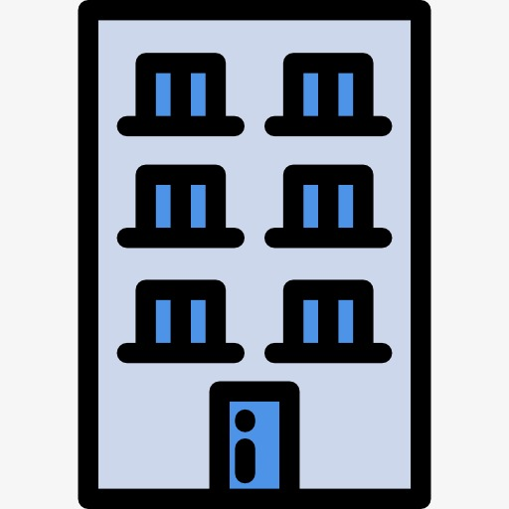
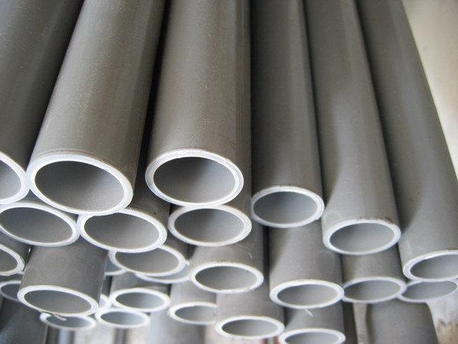
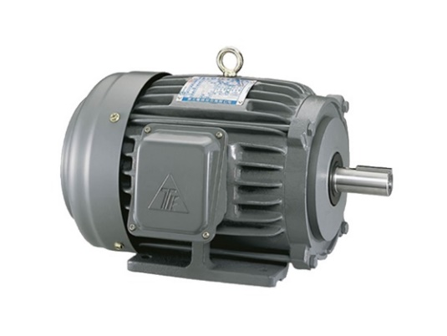
水電工
SVV,SV,CO,
CI,GEDI,EVLWI
PVPI,SVR,SVRI
SVI,GEF,CFI

Slide 20
Recent studies suggest a strong association between time spent with intraoperative hypotension and risk of postoperative morbidity & mortality
35%
AKI (Acute Kidney Injury) increased risk when > 28 min MAP < 65 mmHg²
60%
MI (Myocardial injury) increased risk when >28min MAP < 65 mmHg²
2x
Stroke
Increased above population attributable risk when clinically significant hypotension³
3x
30-day mortality
when MAP decreased from 80 to 50 mmHg⁴
2. Salmasi et al. Anesthesiology 2017; 126:00-00 3. POISE Study Group, Lancet 2008; 371: 1839–47 4. Mascha, E.J. et al., Anesthesiology 2015; 123:79-91
Notes:
Note: Intraoperative hypotension may be a surrogate/predictor for prolonged postoperative hypotension. Consider more frequent haemodynamic monitoring in the ‘golden’ postoperative hours.
最近的研究表明，術中低血壓時間長短與術後發病率和死亡率之間存在很大關聯

Slide 21
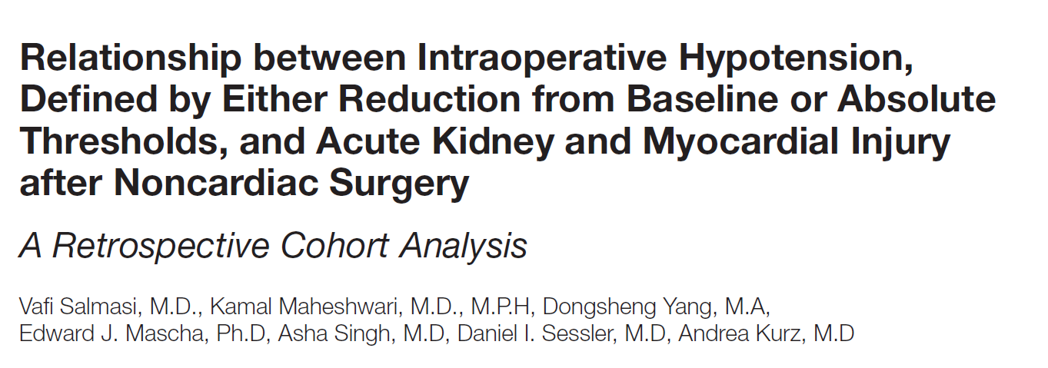
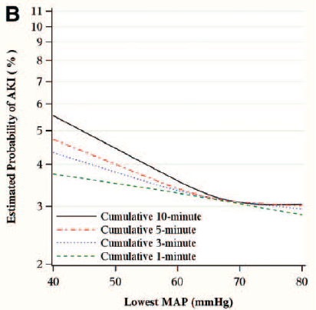
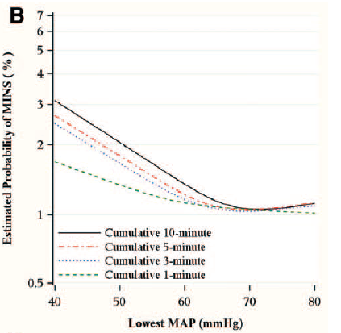
AKI/MI and hypotension
“At a MAP of 50 mmHg, for example, just 1 min significantly increased
the risk for both myocardial and kidney injury”²
Risk of AKI
Risk of MI
AKI and myocardial injury are common, strongly associated with morbidity and mortality, and costly.
MAP less than 65 mmHg was associated with the development of AKI and myocardial injury
Risk escalates rapidly with increasing duration of hypotension and there does not appear to be any safe duration of a MAP < 55 mmHg
2. Salmasi et al. Anesthesiology 2017; 126:00-00
Notes:
Done
Walsh et al.
“例如，在MAP為50 mmHg的情況下，僅增加1分鐘即可心肌和腎臟受傷的風險”

Slide 22
Underlying mechanism of hypotension
Blood Pressure
Cardiac Output
X
Systemic Vascular Resistance
Heart Rate
X
Stroke Volume
Arrhythmias
Tachycardia
Bradycardia
Fibrillation
Structural Heart Disease
Valve disease
Ischemic heart disease
Pericardial disease
Cardiomyopathy
Hypovolemia
Blood loss
Dehydration
Diuresis
Orthostatic volume shift
Systemic Vasodilation/vaso-constriction
Sepsis
Drugs - e.g. regional anesthesia, induction and inhalational agents, etc.
Compensated shock
Excessive vasopressor
SVI
SVV, SV response to Volume
Cause of Hypotension
SVR,SVRI
Notes:
7. Cardiovascular Physiology Concepts Richard E. Klabunde, PhD http://www.cvphysiology.com/Blood%20Pressure/BP030

Slide 23
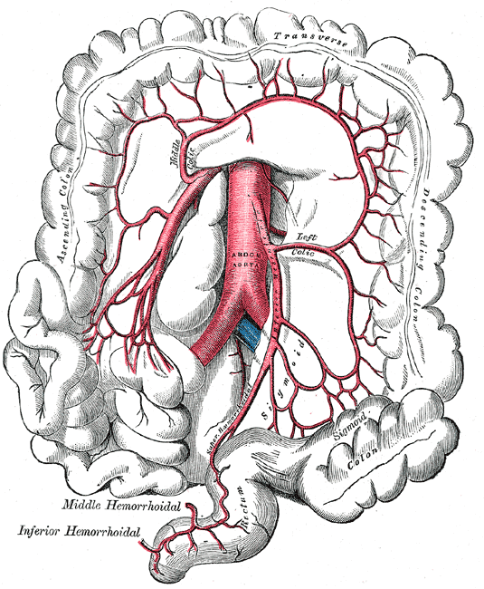
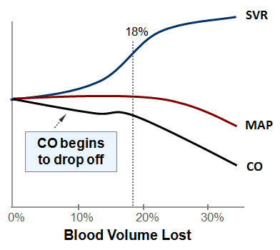
The Pathogenesis of GI Complications
Notes:
當CO開始下降的時候,週邊血管阻力就會上升來維持一個好的BP,身體會盡量維持,一直到血流lost到超過百分之20後,
血壓才微服的下降,事實上要接近30%時才會有明顯的下降,CO在較早時就開始下降了,此時腸胃道的血流就會被用來供應最主要器官,
像是心肺等重要的器官,就會犧牲掉其他,也就是棄卒保帥,雖然保住了帥,但是卒已經都陣亡了,而卒陣亡了,帥也不一定保得住.

Slide 24
Hypotension and hemodynamic changes
BP | HR | CO | SVR | SVV
Hypovolemia
Cardiac dysfunction
1
Cause of hypotension*
Vasodilation
1
1. May be increased with compensated state
*cause of hypotension and managing hypotension values sourced from published literature and text
Notes:
Reference 9. Cardiac Function During Hypovolemia D. L. TRABER, 1. MEYER, and L. D. TRABER G. Schlag et al. (eds.), Pathophysiology of Shock, Sepsis, and Organ Failure
10. Pulse pressure variation and stroke volume variation under different inhaled concentrations of isoflurane, sevoflurane and desflurane in pigs undergoing hemorrhage
11. Cardiovascular Physiology Concepts Richard E. Klabunde, PhD http://www.cvphysiology.com/Heart%20Failure/HF003#Integration_of_Cardiac_and_Vascular_Changes_
12. The effects of vasoactive drugs on pulse pressure and stroke volume variation in postoperative ventilated patients Mehrnaz Hadian, MD, Donald A. Severyn, MS, and Michael R. Pinsky, MD Crit Care. 2011 June
13. Cardiovascular Physiology Concepts Richard E. Klabunde, PhD http://www.cvpharmacology.com/vasodilator/vasodilators

Slide 25
Hypotension and hemodynamic changes
BP | HR | CO | SVR | SVV
Hypovolemia
Cardiac dysfunction
1
Cause of hypotension*
Vasodilation
1
1. May be increased with compensated state
*cause of hypotension and managing hypotension values sourced from published literature and text
Notes:
Reference 9. Cardiac Function During Hypovolemia D. L. TRABER, 1. MEYER, and L. D. TRABER G. Schlag et al. (eds.), Pathophysiology of Shock, Sepsis, and Organ Failure
10. Pulse pressure variation and stroke volume variation under different inhaled concentrations of isoflurane, sevoflurane and desflurane in pigs undergoing hemorrhage
11. Cardiovascular Physiology Concepts Richard E. Klabunde, PhD http://www.cvphysiology.com/Heart%20Failure/HF003#Integration_of_Cardiac_and_Vascular_Changes_
12. The effects of vasoactive drugs on pulse pressure and stroke volume variation in postoperative ventilated patients Mehrnaz Hadian, MD, Donald A. Severyn, MS, and Michael R. Pinsky, MD Crit Care. 2011 June
13. Cardiovascular Physiology Concepts Richard E. Klabunde, PhD http://www.cvpharmacology.com/vasodilator/vasodilators

Slide 26
Stroke Volume Variation Optimization SVV
非自主呼吸病人
YES
NO

Slide 27
Stroke Volume Optimization SV
自主呼吸病人
Stroke Volume (SV)
200 – 250 ml Fluid
等待 5 – 10分鐘變化
YES
YES
NO
SV 增加大於10%
SV 減少小於10%
持續監測臨床液體流失狀況
NO

