Slide 1
Cognitive approaches to clinical reasoning, judgment and decision-making
Kevin W. Eva
Department of Medicine
Centre for Health Education Scholarship
University of British Columbia

Slide 3
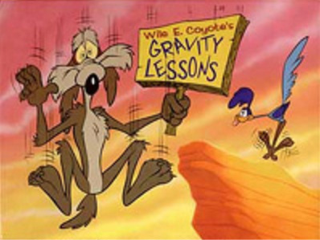
When care fails

Slide 4
When care fails
Medical error
Cognitive accounts of diagnostic error
Finding balance in decision-making
Implications

Slide 5
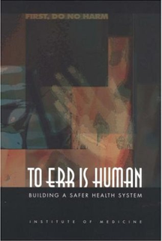
Headlines
‘More likely to die in hospital than plane crash’
(Irish Times, 2005)
‘Going into hospital far riskier than flying: WHO’
(Reuters, 2011)
Notes:
Irish times article: 1/300 chance of dying from medical negligence; 1/3,000,000 chance of dying in plane crash
IOM report: 2000
In 2003, $50M spent to set up the CPSI

Slide 6
Expectations
Performance
Med School
Residency
Practice
Experience

Slide 7
The problem with experience
(see Eva, 2002)
Performance
Med School
Residency
Practice
Experience

Slide 8
Relationship between experience and performance
Systematic review retrieved 62 studies relating medical knowledge and health care quality to years in practice
(Choudhry, Fletcher, and Soumerai, 2005)

Slide 9
Why?

Slide 11
Statistics
Rate of diagnostic error in medicine:
10-15%
Proportion of errors with cognitive cause:
74%
(see Graber et al., 2005)
Notes:
Irish times article: 1/300 chance of dying from medical negligence; 1/3,000,000 chance of dying in plane crash
$50M spent to set up the CPSI

Slide 12
The early days of expertise
The ‘60s and ‘70s
Expertise characterized as the development of generic problem solving skills
The goal of PBL: Create good problem solvers
Evaluation tools (e.g., PMPs) - focused on objectively measuring problem solving tendencies
See Norman (2005)

Slide 13
The fall of an empire
Process differences hard to come by
E.g., 5 to 7 hypotheses typically generated early in the course of a case by both experts and novices
(Barrows, et al., 1982; Neufeld, et al., 1981)
Context specificity omnipresent
Performance across problems unrelated
(Elstein, et al., 1978; Eva, 2003)

Slide 14
What is being taught?

Slide 15
Traditional models of reasoning
Tend to be analytic in nature
Advocate careful, controlled consideration of features
Treat features as plainly evident
Treat expertise as development and elaboration of rules
Treat reasoning as an application of these rules
E.g., Bayes’ theorem:
Pre-test odds x Likelihood ratio = Post-test odds

Slide 16
Avoid premature closure
“Be objective”
“Don’t jump the gun”
“Collect all of the available information before making a decision”

Slide 17
With good reason…

Slide 19
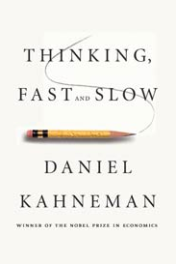
Non-analytic processes
System 1
Pattern recognition
Effortless, automatic, unconscious
Contributing Factor:
Working memory limitations
Effect:
Errors: Confirmation bias, etc.

Slide 20
Caulford et al. (1994)
Most prevalent errors were those that correlate with premature closure:
Interviews - abrupt - 43%
History taking - not comprehensive - 90%
Problem solving - data gathering incomplete - 67%
Management - failed to consider important strategy - 97%
Record keeping - important details omitted - 93%
Risk appeared greater with increasing years of experience

Slide 21
Eva & Cunnington (2006)
Manipulated order in which information was presented to determine how much influence is held by features encountered early
Example:
Pneumonia before Pulmonary Embolus
vs.
Pulmonary Embolus before Pneumonia

Slide 22
Eva & Cunnington (2006)
More experienced physicians more likely to base decisions on their first impressions

Slide 23
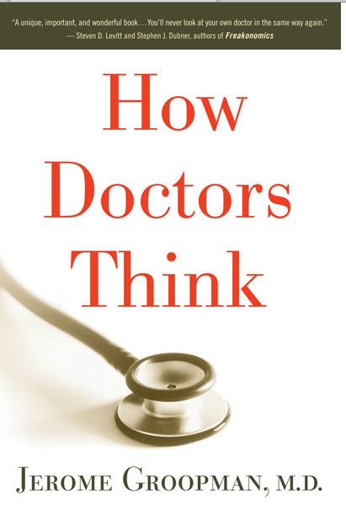
What else
could it be?
Is there anything that doesn’t fit?

Slide 24
Overcoming the evil
“Cognitive forcing strategies … are designed to prevent clinicians from pursuing a pattern recognition path that will typically lead to error”
Croskerry (2002)

Slide 26
Overcoming the evil
“Cognitive forcing strategies … are designed to prevent clinicians from pursuing a pattern recognition path that will typically lead to error”
Croskerry (2002)

Slide 27
An artificial dichotomy
Non-analytic
processes
Analytic
processes
Combined
Influential variables:
Fatigue, age, distractions, etc.
(See Jacoby, et al., 1997; Eva, 2005)

Slide 28
Value from System 1
(Eva and Regehr, 2007)

Slide 29
Ark, Brooks, and Eva (2006)

Slide 30
Ark, Brooks, and Eva (2006)

Slide 31
Eva, Hatala, et al. (2007)
Psychology students
ECG Slides
Sibbald et al. (2012)
Medical students
Harvey Heart Sounds
p<0.05
n.s.
p<0.05
n.s.

Slide 32
Summary
It is important to recognize that exclusive reliance on non-analytic processes creates error …
… but so does absolute aversion to those processes

Slide 33
Summary
Dominant discourse around diagnostic error: Heuristics bad
Problems arising from that discourse:
Overlooking the fact that any strategy can lead to errors and successes
Reinforcing the tendency for students to want to be right rather than to learn how

Slide 34
Heuristics and biases
Offer ways of simplifying a complex world
…that can cause problems
…but can’t be turned off
…with good reason
(see Wegwarth, Gaissmeier, Gigerenzer, 2009)

Slide 35
A fine balance?
Formal Knowledge Experiential Knowledge
Risk of inexperience
Risk of experience
Performance
Med School
Residency
Practice
Experience

Slide 36
The real influence of experience
(See Eva, 2002)

Slide 37
What does this mean for medical education?

Slide 38
Implications
For training:
Teach around many examples
While explicitly empowering dual processes
For practice:
Embrace review and enhancement programs
Within communities of practice
Without limiting discussion to guideline-based “do’s and don’ts”
See Eva, et al. (1998); Eva (2002; 2005; 2009)

Slide 39
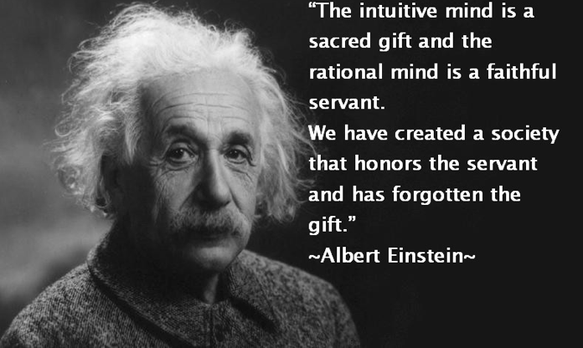

Slide 40
Thanks
kevin.eva@ubc.ca
References available on request

